Slide 1
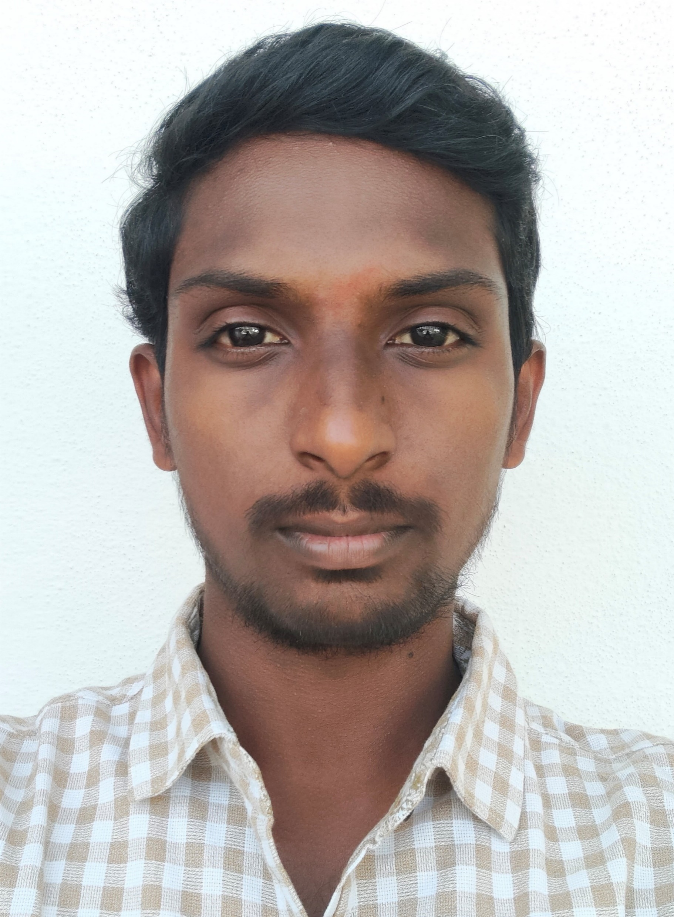


Asokan Bharath Kumar
Analyst/Software Engineer
Bachelor of Engineering
Electronic and Communication
: 2017 - 2021
Skills
Bangalore
asokan-bharath.kumar@capgemini.com
Java 8 /J2EE | Java Basics, OOPS, Generics, Collections, Arrays, Loops, Lambda Exp, Stream API Junit, Mockito.
Spring core | IOC & Dependency Injection, Autowire.
Spring REST | REST controllers, Implementation of GET, POST, PUT & DELETE, Bean Validation & Exception Handling, Testing Services, Controller & Repository layer.
Database | MongoDB No Sql Basics.
Spring Boot Microservices | Spring Boot Starters, annotations, Swagger API documents.
Spring Cloud | Eureka, Netflix Hystrix , Netflix Zuul & Config Server.
Angular | Components, Services, Modules, Routing, Forms & Validation, Testing using Jasmine & Karma.
UI Tech | HTML 5 & CSS 3,JavaScript, ES6 & TypeScript Reusable templates, Optimized UI Designed.
Tools | Git, Postman, Maven, IDE
Add On skills | Communications, Team management. Peer learning.
+91 8977977123
A4
Hands on experience in creating microservices with Springboot, Spring Security, Spring Cloud API Gateway, Eureka server, load balancing.
Proficient in creating Single page Web Application in Angular with Authentication with route guards, Angular reactive forms, angular routing , HTML and CSS.
Experience in creating documentation with Java docs and swagger and in unit testing using Junit, Mockito.
Java Microservice Development knowledge using Spring boot and spring cloud framework on an intermediate level.
Online Railway Reservation System
Completed end to end case study of Railway Reservation System Application along with JWT authentication, Swagger and payment testing using Stripe, responsive UI with HTML, CSS and Angular used for user interface.
Check out my work on GitHub & Video Profile

